Slide 1


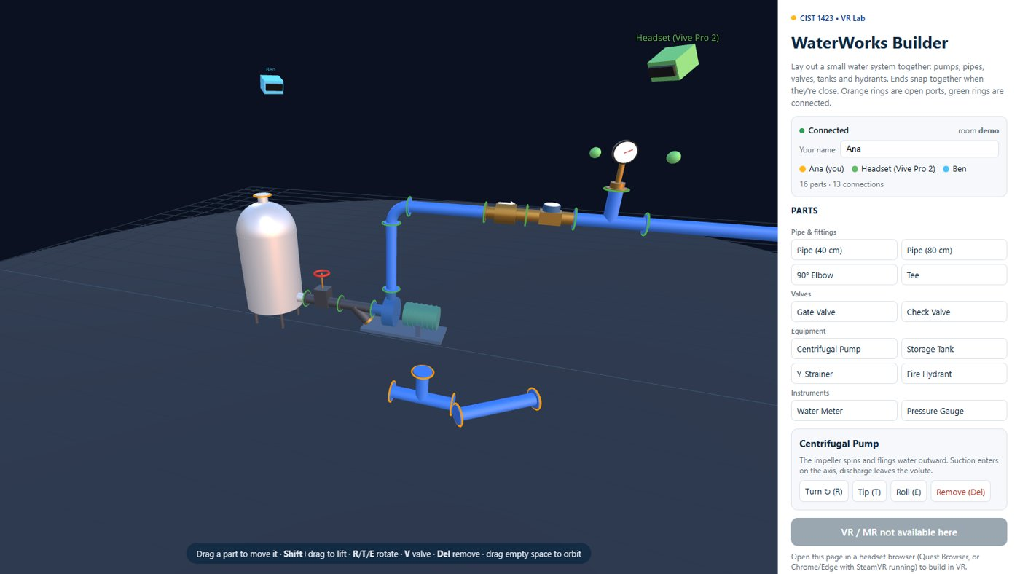

Virtual Reality
Interactive AR: a menu that places and swaps objects in the real world
Wednesdays at 6:00pm
CIST 1423 - 2010 VIRTUAL REALITY PROGRAMMING AND TECHNOLOGY
Homework: an AR menu (place + swap prefab) in your prototype

Slide 2
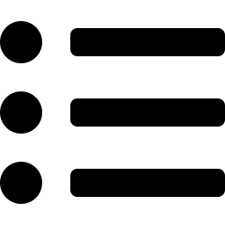


Agenda
The AR menu app
UI + On Click
Same pattern, WaterWorks
Food data, ARPlacePrefab, SwapPrefab
Buttons that change what gets placed
Palette → spawn, shelf → place

Slide 3

Today
By the end of class you can…
Build the Ch. 6 menu app: data, place, swap
Tonight's plan
1
0–10
Review
Raycast from a touch against detected planes
2
10–40
AR menu: Food, ARPlacePrefab, SwapPrefab
40–50
Lab briefing
Wire UI Buttons to methods without code (On Click)
3
50–130
Lab: place + swap in your AR prototype
130–145
Share-out
145–150
Exit ticket
CIST 1423 — Week 10 — Building Interactive AR Experiences (Ch. 6)

Slide 4



The Ch. 6 app in three scripts
Pick a dish from a menu, tap a table, see it at real size; tap another dish to swap it.
Food (data)
ARPlacePrefab
SwapPrefab
Name, price, prefab reference
A ScriptableObject or a simple class
The menu is a list of these
Tap → raycast against detected planes
First tap: Instantiate the selected prefab at the hit pose
Later taps: move it
Menu button changes the selected Food
Destroy the placed object, Instantiate the new prefab at the same pose
CIST 1423 — Week 10 — Building Interactive AR Experiences (Ch. 6)

Slide 5


ARPlacePrefab: tap to place on a plane
ARRaycastManager does the "which real surface did I tap?" work.
[RequireComponent(typeof(ARRaycastManager))]
public class ARPlacePrefab : MonoBehaviour
{
public GameObject prefab; // set by the menu
GameObject placed;
ARRaycastManager raycaster;
static readonly List<ARRaycastHit> hits = new();
void Awake() => raycaster = GetComponent<ARRaycastManager>();
void Update()
{
if (Input.touchCount == 0) return;
Touch touch = Input.GetTouch(0);
if (touch.phase != TouchPhase.Began) return;
if (!raycaster.Raycast(touch.position, hits,
TrackableType.PlaneWithinPolygon)) return;
Pose pose = hits[0].pose;
if (placed == null)
placed = Instantiate(prefab, pose.position, pose.rotation);
else
placed.transform.SetPositionAndRotation(pose.position, pose.rotation);
}
}
PlaneWithinPolygon
Only hits inside a detected plane’s outline
Not just its infinite extension
Don’t place through the UI
Check EventSystem.current.IsPointerOverGameObject(touch.fingerId) first
CIST 1423 — Week 10 — Building Interactive AR Experiences (Ch. 6)

Slide 6


SwapPrefab: the menu buttons
Each dish button calls Swap with its prefab: remember the pose, replace the object.
// in ARPlacePrefab
public void Swap(GameObject next) // UI Button -> On Click
{
prefab = next;
if (placed == null) return; // nothing placed yet
var pose = new Pose(placed.transform.position,
placed.transform.rotation);
Destroy(placed);
placed = Instantiate(prefab, pose.position, pose.rotation);
}
Wire it up (no code)
Button → On Click (+)
Drag in the XR Origin
Pick ARPlacePrefab.Swap
Drag the dish prefab into the argument
With Food data
Button label = food.name + food.price
Argument = food.prefab
CIST 1423 — Week 10 — Building Interactive AR Experiences (Ch. 6)

Slide 7
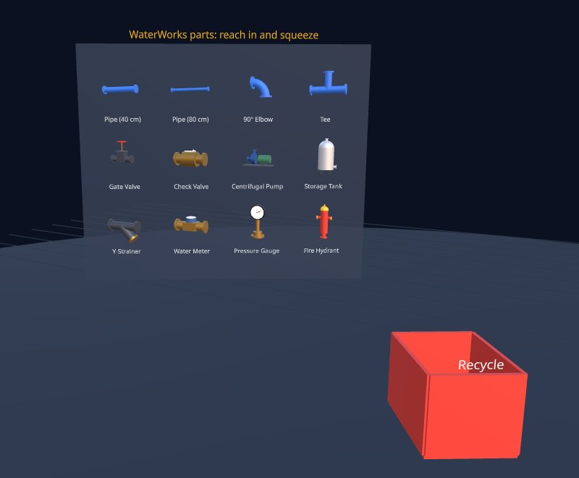
The same "menu → place → swap" pattern in WaterWorks
Menu = palette/shelf, placement = spawn at a pose, swap = delete + spawn at the same pose.
Desktop palette: each button spawns a part type near the view centre
In the headset: the shelf is the menu, reaching in is the "tap"
Exercise: add a "swap" to WaterWorks: select a pipe and turn it into a gate valve at the same pose.
CIST 1423 — Week 10 — Building Interactive AR Experiences (Ch. 6)

Slide 8
Check your understanding
Answer with a partner first, then we'll compare.
Q1
Q2
Q3
What does TrackableType.PlaneWithinPolygon filter for?
How does Swap keep the object in the same place?
Why check IsPointerOverGameObject before raycasting?
CIST 1423 — Week 10 — Building Interactive AR Experiences (Ch. 6)
Notes:
Answers:
Q1. What does TrackableType.PlaneWithinPolygon filter for?
Hits inside a detected plane's outline, not its infinite extension.
Q2. How does Swap keep the object in the same place?
It saves the placed object's pose, destroys it, and instantiates the new prefab at that pose.
Q3. Why check IsPointerOverGameObject before raycasting?
So tapping a menu button doesn't also place an object behind it.

Slide 9

Next steps: homework + planning
Implement an AR menu interaction (place + swap prefab) in your AR prototype, or a swap in your WebXR fork
Submit via GitHub with a Markdown reflection
Next week: Ch. 7, sound and visual effects (Exam 3)
CIST 1423 — Week 10 — Building Interactive AR Experiences (Ch. 6)

